Slide 1
Drone Phenology Monitoring
Gaurav Rajput
Parth Thakur

Slide 2
Overview
Recent progress
Classifying into different cases of matching
Handling strategy for each case
Hungarian cost metric experimentation

Slide 3
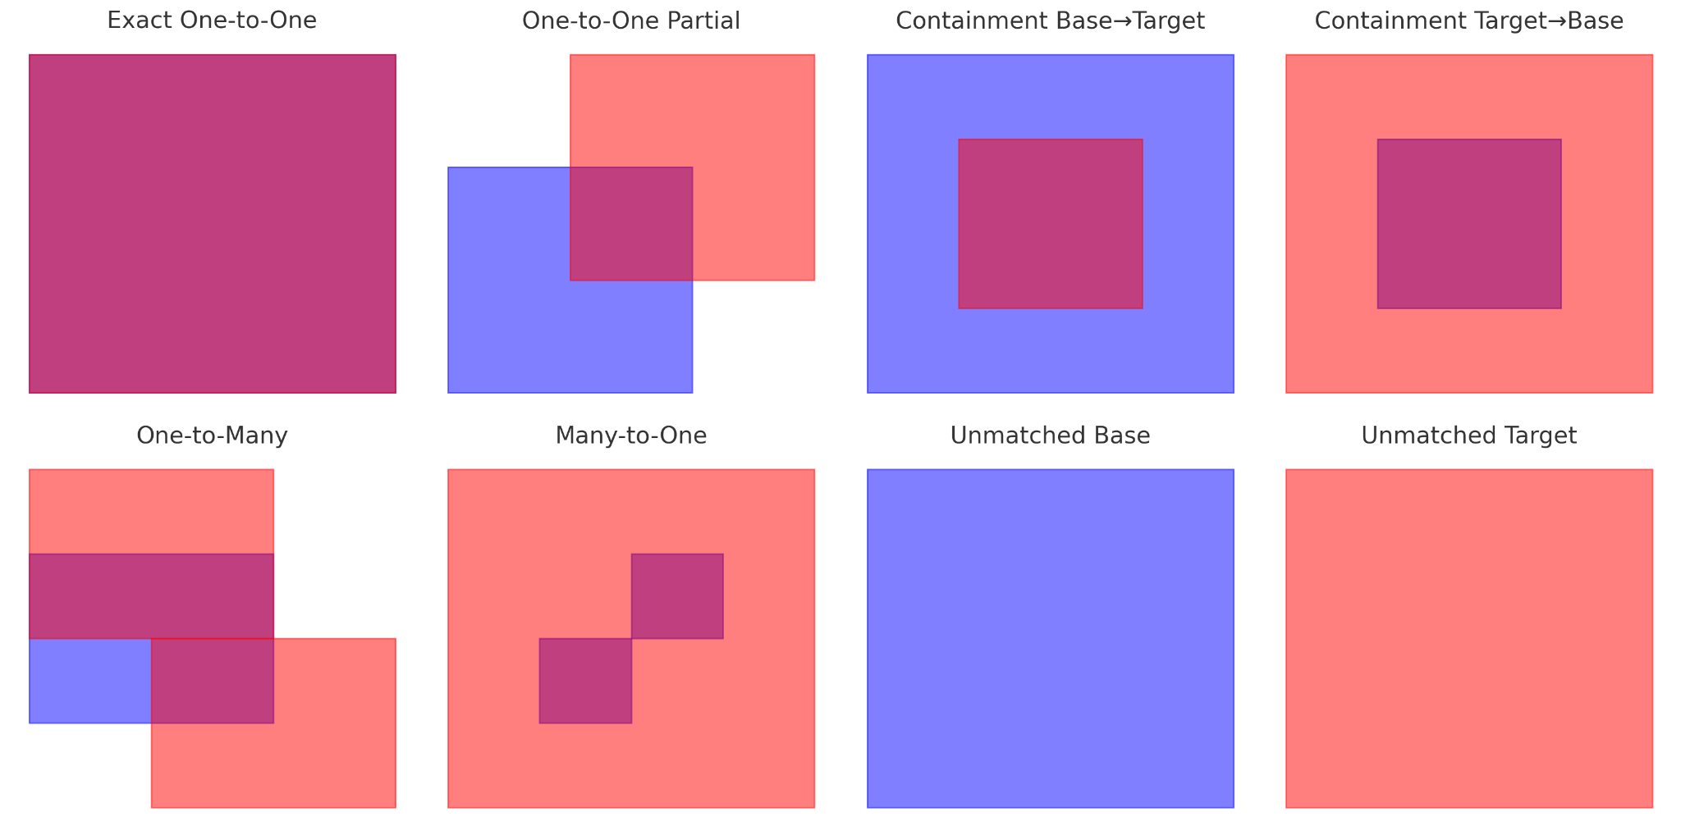
Different cases of matching

Slide 4
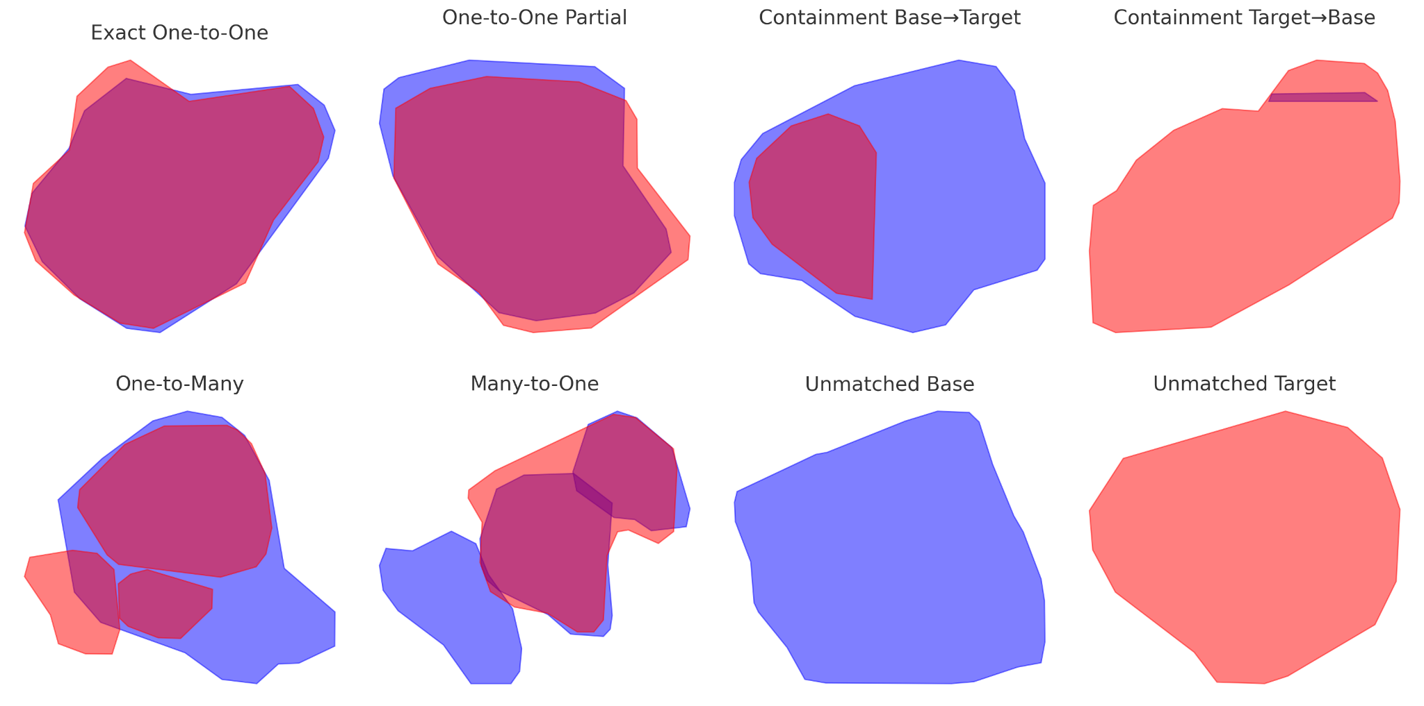
Different cases of matching SIT OM

Slide 5
Different cases of matching
Case | Condition
Exact One-to-One | One base & one target overlap, IoU ≥ 90 % (and any other overlaps IoU < 10 %).
One-to-One Partial | One base & one target overlap, threshold < IoU < 90 %, neither contains the other.
Containment Base → Target | One base overlaps one target, and base contains (target) (IoU may be low).
Containment Target → Base | One base overlaps one target, and target contains (base) (IoU may be low).
One-to-Many | One base overlaps ≥ 2 targets, none with IoU ≥ 90 %.
Many-to-One | One target overlaps ≥ 2 bases, none with IoU ≥ 90 %.
Unmatched Base | Base polygon has zero overlapping targets.
Unmatched Target | Target polygon has zero overlapping bases.

Slide 6
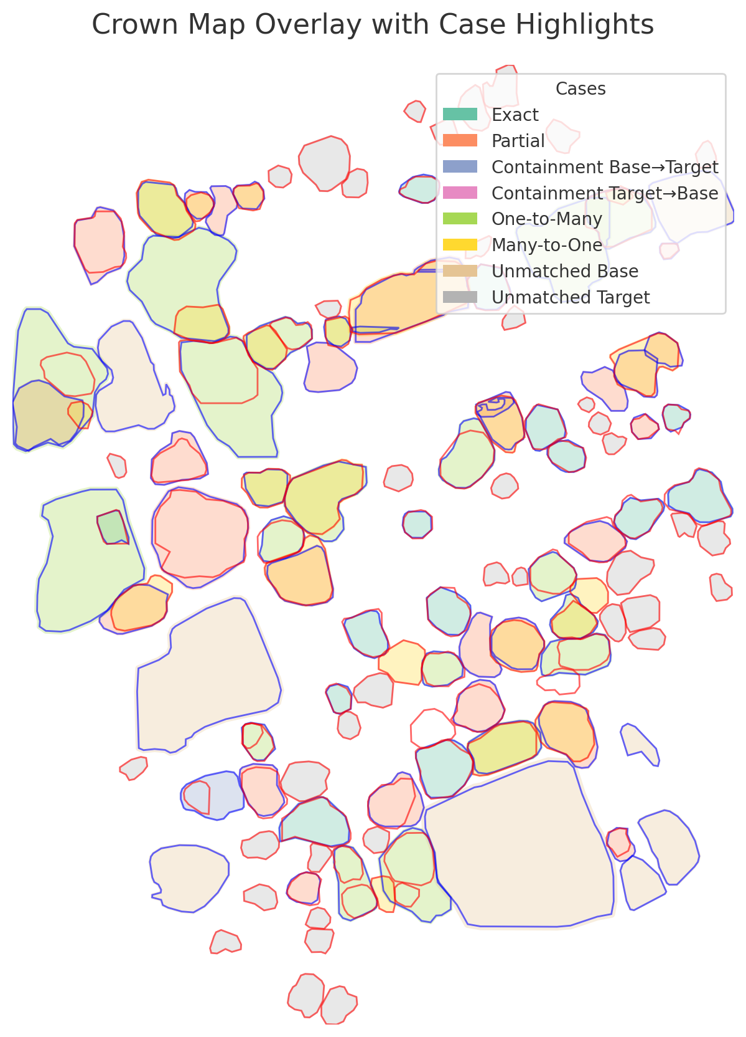

Slide 7
Case | ID Assignment Strategy
Exact One-to-One | Assign the same ID to both base and target polygons.
One-to-One Partial | If IoU ≥ 50%, assign the same ID and flag for review. Otherwise give the target a new ID.
Containment Base→Target | Assign the base’s ID to the target polygon. Archive the extra base area for later.
Containment Target→Base | Assign the target’s ID to the base polygon. Archive the extra target area for later.
One-to-Many | Merge the overlapping targets and assign the merged shape the base’s ID. Discard or re-ID small fragments below a noise threshold.
Many-to-One | Split the target by intersecting with each base polygon. Assign each piece the corresponding base’s ID.
Unmatched Base | Keep the base’s ID and mark it as missing in this run. Flag for manual or automated re-detection.
Unmatched Target | Assign a new temporary ID. Promote it to a persistent ID only if it appears in later runs.

Slide 8
Using multiple detectree runs?
Diverse Prediction Ensemble
Run the model multiple times on each orthomosaic, varying:
Confidence thresholds
Tile sizes or overlap strides
Random seeds, or minor image augmentations (brightness, rotation).
Pool all detections per date into a “bank” of polygons—this captures both high-confidence consensus crowns and fringe candidates.
Apply Hungarian on the 2 banks from each orthomosaic and do some Post-Match Pruning & Voting

Slide 9
Cost Metric of Hungarian
Euclidean distance may incorrectly assign split detections if their centroids are close to the ground truth
Cost=1−IoU(A,B)
We can also use a combined hybrid metric
λ*IoU + (1-λ)*centroid_distance
This proved to be better suppose:
IoU = 0.5 → higher But centroid distance = 15m → way too far to be the same tree If we use only IoU:It might pick the wrong, faraway crown just because overlap is slightly better.If you combine IoU + centroid distance:It correctly favors the closer, more likely match, even if IoU isn't perfect. That’s why we are getting better results.

